Slide 1

DIVINE GRACE COLLEGE OF ARTS, SCIENCE AND TECHNOLOGY
(DGCAST) — GAROUA | GEOGRAPHY DEPARTMENT
UPPER SIXTH ARTS — ENVIRONMENT AND DEVELOPMENT — LESSON 2
Deforestation and Desertification
Mr KAMDEM EMMANUEL
Geography Teacher — PLEG
Academic Year 2026 / 2027
Notes:
Good morning, class. Today we study Lesson 2: Deforestation and Desertification.

Slide 2
GEOGRAPHY — UPPER SIXTH ARTS
CLASS INFO
Class, Chapter & Duration
Class | Upper Sixth Arts
Chapter | Module 7: Understanding and managing contemporary environmental and development issues
Duration | 2 periods (2 × 50 minutes)
2026 / 2027
DGCAST GAROUA — GEOGRAPHY DEPARTMENT
Mr KAMDEM E. | 2

Slide 3
GEOGRAPHY — UPPER SIXTH ARTS
IDENTIFICATION
Lesson Identification
Topic | Contemporary Environmental Issues
Sub-topic | Environmental Degradation
Lesson | Lesson 2: Deforestation and Desertification
Notions / Concepts | Deforestation, desertification, overgrazing, afforestation, reforestation, Green Wall.
Syllabus focus | Meaning and examples; causes; consequences; preventive and corrective measures.
Competence | Learners are able to explain the causes and consequences of deforestation and desertification and propose measures.
2026 / 2027
DGCAST GAROUA — GEOGRAPHY DEPARTMENT
Mr KAMDEM E. | 3

Slide 4
GEOGRAPHY — UPPER SIXTH ARTS
OBJECTIVES
Learning Objectives
By the end of the lesson, the learner should be able to:
Define deforestation and desertification with examples.
Explain their causes and consequences.
Propose preventive and corrective measures.
2026 / 2027
DGCAST GAROUA — GEOGRAPHY DEPARTMENT
Mr KAMDEM E. | 4

Slide 5
GEOGRAPHY — UPPER SIXTH ARTS
RECALL
Recall
Trees protect the soil.
The Far North of Cameroon is close to the Sahara.
2026 / 2027
DGCAST GAROUA — GEOGRAPHY DEPARTMENT
Mr KAMDEM E. | 5

Slide 6
GEOGRAPHY — UPPER SIXTH ARTS
REAL-LIFE SITUATION
Real-Life Situation
In the East Region, large areas of forest are cut for timber and farms. In the Far North, trees are cut for firewood, cattle eat all the grass and sand begins to cover fields.
2026 / 2027
DGCAST GAROUA — GEOGRAPHY DEPARTMENT
Mr KAMDEM E. | 6
Notes:
Read the situation slowly, twice.

Slide 7
GEOGRAPHY — UPPER SIXTH ARTS
REAL-LIFE SITUATION
Situation — Question 1
What is the problem in the situation?
2026 / 2027
DGCAST GAROUA — GEOGRAPHY DEPARTMENT
Mr KAMDEM E. | 7

Slide 8
GEOGRAPHY — UPPER SIXTH ARTS
REAL-LIFE SITUATION
Answer
Forests are destroyed and land is becoming desert.
2026 / 2027
DGCAST GAROUA — GEOGRAPHY DEPARTMENT
Mr KAMDEM E. | 8

Slide 9
GEOGRAPHY — UPPER SIXTH ARTS
REAL-LIFE SITUATION
Situation — Question 2
What is the loss of forest called?
2026 / 2027
DGCAST GAROUA — GEOGRAPHY DEPARTMENT
Mr KAMDEM E. | 9

Slide 10
GEOGRAPHY — UPPER SIXTH ARTS
REAL-LIFE SITUATION
Answer
Deforestation.
2026 / 2027
DGCAST GAROUA — GEOGRAPHY DEPARTMENT
Mr KAMDEM E. | 10

Slide 11
GEOGRAPHY — UPPER SIXTH ARTS
REAL-LIFE SITUATION
Situation — Question 3
What is the spread of desert conditions called?
2026 / 2027
DGCAST GAROUA — GEOGRAPHY DEPARTMENT
Mr KAMDEM E. | 11

Slide 12
GEOGRAPHY — UPPER SIXTH ARTS
REAL-LIFE SITUATION
Possible Answer
Desertification.
2026 / 2027
DGCAST GAROUA — GEOGRAPHY DEPARTMENT
Mr KAMDEM E. | 12

Slide 13
GEOGRAPHY — UPPER SIXTH ARTS
JUSTIFICATION
Justification of the Lesson
This lesson helps us to protect forests and fight desertification.
2026 / 2027
DGCAST GAROUA — GEOGRAPHY DEPARTMENT
Mr KAMDEM E. | 13

Slide 14

GEOGRAPHY — UPPER SIXTH ARTS
I. MEANING
Activity 1
A forest cleared by logging.
2026 / 2027
DGCAST GAROUA — GEOGRAPHY DEPARTMENT
Mr KAMDEM E. | 14
Notes:
Without the projector: describe cut forests you know.

Slide 15
GEOGRAPHY — UPPER SIXTH ARTS
I. MEANING
Activity 1: Question
What is deforestation?
2026 / 2027
DGCAST GAROUA — GEOGRAPHY DEPARTMENT
Mr KAMDEM E. | 15

Slide 16
GEOGRAPHY — UPPER SIXTH ARTS
I. MEANING
Answer
The removal of forests for timber, farming or building.
2026 / 2027
DGCAST GAROUA — GEOGRAPHY DEPARTMENT
Mr KAMDEM E. | 16

Slide 17
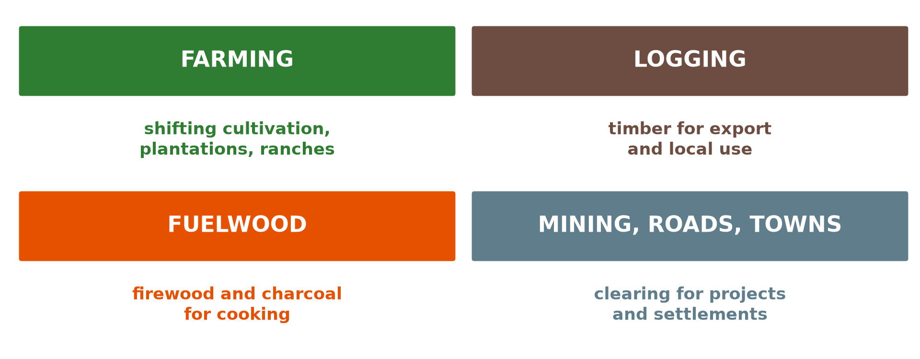
GEOGRAPHY — UPPER SIXTH ARTS
II. CAUSES OF DEFORESTATION
Activity 2
Causes of deforestation.
2026 / 2027
DGCAST GAROUA — GEOGRAPHY DEPARTMENT
Mr KAMDEM E. | 17
Notes:
Without the projector: list causes in your region.

Slide 18
GEOGRAPHY — UPPER SIXTH ARTS
II. CAUSES OF DEFORESTATION
Activity 2: Question
Give three causes of deforestation.
2026 / 2027
DGCAST GAROUA — GEOGRAPHY DEPARTMENT
Mr KAMDEM E. | 18

Slide 19
GEOGRAPHY — UPPER SIXTH ARTS
II. CAUSES OF DEFORESTATION
Answer
Farming, logging and fuelwood (also mining and roads).
2026 / 2027
DGCAST GAROUA — GEOGRAPHY DEPARTMENT
Mr KAMDEM E. | 19

Slide 20
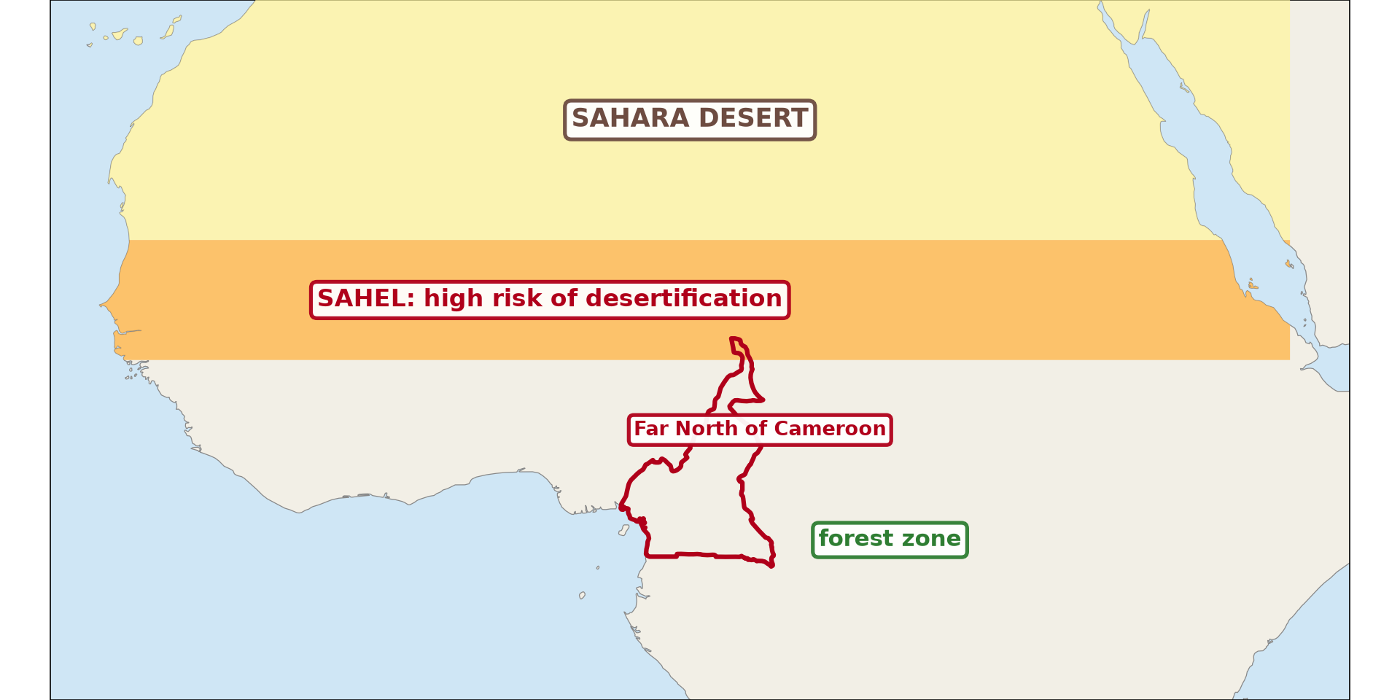
GEOGRAPHY — UPPER SIXTH ARTS
III. DESERTIFICATION
Activity 3
The Sahel, at risk of desertification.
2026 / 2027
DGCAST GAROUA — GEOGRAPHY DEPARTMENT
Mr KAMDEM E. | 20
Notes:
Without the projector: locate the Sahel.

Slide 21
GEOGRAPHY — UPPER SIXTH ARTS
III. DESERTIFICATION
Activity 3: Question
Where is desertification most serious in Africa?
2026 / 2027
DGCAST GAROUA — GEOGRAPHY DEPARTMENT
Mr KAMDEM E. | 21

Slide 22
GEOGRAPHY — UPPER SIXTH ARTS
III. DESERTIFICATION
Answer
In the Sahel, south of the Sahara, including the Far North of Cameroon.
2026 / 2027
DGCAST GAROUA — GEOGRAPHY DEPARTMENT
Mr KAMDEM E. | 22

Slide 23
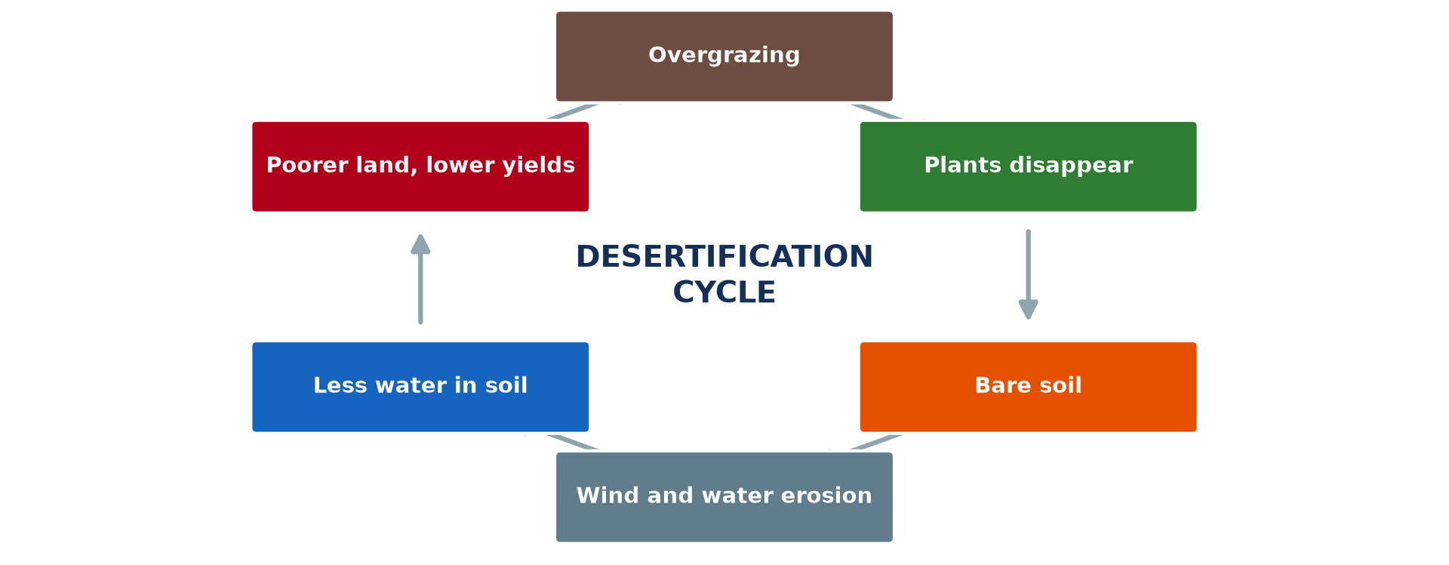
GEOGRAPHY — UPPER SIXTH ARTS
III. CAUSES OF DESERTIFICATION
Activity 4
The desertification cycle.
2026 / 2027
DGCAST GAROUA — GEOGRAPHY DEPARTMENT
Mr KAMDEM E. | 23
Notes:
Without the projector: follow the cycle.

Slide 24
GEOGRAPHY — UPPER SIXTH ARTS
III. CAUSES OF DESERTIFICATION
Activity 4: Question
How does overgrazing lead to desertification?
2026 / 2027
DGCAST GAROUA — GEOGRAPHY DEPARTMENT
Mr KAMDEM E. | 24

Slide 25
GEOGRAPHY — UPPER SIXTH ARTS
III. CAUSES OF DESERTIFICATION
Answer
Animals remove plants, the soil is bare and is eroded by wind and water.
2026 / 2027
DGCAST GAROUA — GEOGRAPHY DEPARTMENT
Mr KAMDEM E. | 25

Slide 26

GEOGRAPHY — UPPER SIXTH ARTS
IV. MEASURES
Activity 5
Planting trees in the Sahel.
2026 / 2027
DGCAST GAROUA — GEOGRAPHY DEPARTMENT
Mr KAMDEM E. | 26
Notes:
Without the projector: discuss tree planting.

Slide 27
GEOGRAPHY — UPPER SIXTH ARTS
IV. MEASURES
Activity 5: Question
Give two measures against desertification.
2026 / 2027
DGCAST GAROUA — GEOGRAPHY DEPARTMENT
Mr KAMDEM E. | 27

Slide 28
GEOGRAPHY — UPPER SIXTH ARTS
IV. MEASURES
Answer
Tree planting (Green Wall, Sahel Vert) and controlled grazing (also improved stoves).
2026 / 2027
DGCAST GAROUA — GEOGRAPHY DEPARTMENT
Mr KAMDEM E. | 28

Slide 29
GEOGRAPHY — UPPER SIXTH ARTS
BOARD SUMMARY
Deforestation and Desertification
Topic: Contemporary Environmental Issues
Sub-topic: Environmental Degradation
Lesson 2: Deforestation and Desertification
2026 / 2027
DGCAST GAROUA — GEOGRAPHY DEPARTMENT
Mr KAMDEM E. | 29
Notes:
Learners copy the board summary now. Give them enough time for each slide.

Slide 30
GEOGRAPHY — UPPER SIXTH ARTS
BOARD SUMMARY
I. Definitions (1/2)
Deforestation: It is the removal of forest cover by people.
Desertification: It is the spread of desert conditions into dry lands, mainly because of human activities and drought.
2026 / 2027
DGCAST GAROUA — GEOGRAPHY DEPARTMENT
Mr KAMDEM E. | 30

Slide 31
GEOGRAPHY — UPPER SIXTH ARTS
BOARD SUMMARY
I. Definitions (2/2)
Afforestation: It is the planting of trees where there were none.
2026 / 2027
DGCAST GAROUA — GEOGRAPHY DEPARTMENT
Mr KAMDEM E. | 31

Slide 32
GEOGRAPHY — UPPER SIXTH ARTS
BOARD SUMMARY
II. Causes and Consequences (1/3)
A. Causes of deforestation: Farming, logging, fuelwood, mining and roads remove forests. Population growth increases the pressure.
B. Causes of desertification: Overgrazing, over-cultivation and cutting trees leave soils bare. Long droughts make the problem worse.
2026 / 2027
DGCAST GAROUA — GEOGRAPHY DEPARTMENT
Mr KAMDEM E. | 32

Slide 33
GEOGRAPHY — UPPER SIXTH ARTS
BOARD SUMMARY
II. Causes and Consequences (2/3)
C. Consequences: Soils are eroded, wildlife is lost and rainfall may fall. Farmers become poorer and migrate.
2026 / 2027
DGCAST GAROUA — GEOGRAPHY DEPARTMENT
Mr KAMDEM E. | 33

Slide 34
GEOGRAPHY — UPPER SIXTH ARTS
BOARD SUMMARY
II. Causes and Consequences (3/3)
Copy the cycle.
2026 / 2027
DGCAST GAROUA — GEOGRAPHY DEPARTMENT
Mr KAMDEM E. | 34

Slide 35
GEOGRAPHY — UPPER SIXTH ARTS
BOARD SUMMARY
III. Measures
A. Preventive: Controlled logging, protected areas and improved stoves reduce tree cutting. Controlled grazing protects grass.
B. Corrective: Reforestation, the Great Green Wall and Operation Sahel Vert restore land. Stone lines and zaï pits help crops grow again.
2026 / 2027
DGCAST GAROUA — GEOGRAPHY DEPARTMENT
Mr KAMDEM E. | 35

Slide 36
GEOGRAPHY — UPPER SIXTH ARTS
FORMATIVE EVALUATION
Formative Evaluation 1
Define desertification and give two causes.
2026 / 2027
DGCAST GAROUA — GEOGRAPHY DEPARTMENT
Mr KAMDEM E. | 36

Slide 37
GEOGRAPHY — UPPER SIXTH ARTS
FORMATIVE EVALUATION
Expected Answer
The spread of desert conditions; overgrazing and cutting trees.
2026 / 2027
DGCAST GAROUA — GEOGRAPHY DEPARTMENT
Mr KAMDEM E. | 37

Slide 38
GEOGRAPHY — UPPER SIXTH ARTS
FORMATIVE EVALUATION
Formative Evaluation 2
Give two preventive and two corrective measures.
2026 / 2027
DGCAST GAROUA — GEOGRAPHY DEPARTMENT
Mr KAMDEM E. | 38

Slide 39
GEOGRAPHY — UPPER SIXTH ARTS
FORMATIVE EVALUATION
Expected Answer
Preventive: controlled grazing, improved stoves. Corrective: reforestation, stone lines.
2026 / 2027
DGCAST GAROUA — GEOGRAPHY DEPARTMENT
Mr KAMDEM E. | 39

Slide 40
GEOGRAPHY — UPPER SIXTH ARTS
REMEDIATION
Remediation
Fill in the blanks:
Removing forests is ______.
Too many animals on land is ______.
Planting trees again is ______.
2026 / 2027
DGCAST GAROUA — GEOGRAPHY DEPARTMENT
Mr KAMDEM E. | 40
Notes:
Answers: 1. deforestation 2. overgrazing 3. reforestation

Slide 41
GEOGRAPHY — UPPER SIXTH ARTS
HOMEWORK
Homework
Interview an elder about changes in trees and grass in your area over the years.
This prepares Lesson 3: Soil Erosion.
2026 / 2027
DGCAST GAROUA — GEOGRAPHY DEPARTMENT
Mr KAMDEM E. | 41
Notes:
This homework prepares the next lesson.

Slide 42
GEOGRAPHY — UPPER SIXTH ARTS
BILINGUAL GAME
Bilingual Game (Jeu Bilingue)
English | Français
Deforestation | La déforestation
Desertification | La désertification
Overgrazing | Le surpâturage
Firewood | Le bois de chauffe
Tree planting | Le reboisement
Drought | La sécheresse
2026 / 2027
DGCAST GAROUA — GEOGRAPHY DEPARTMENT
Mr KAMDEM E. | 42
Notes:
Say the English word; learners give the French word, then the reverse.

Slide 43
GEOGRAPHY — UPPER SIXTH ARTS
LOGBOOK
Official Logbook (1/2)
Module / Topic | Contemporary Environmental Issues
Lesson Title | Lesson 2: Deforestation and Desertification
Expected Learning Outcomes | Define deforestation and desertification with examples. Explain their causes and consequences. Propose preventive and corrective measures.
Competence | Learners are able to explain the causes and consequences of deforestation and desertification and propose measures.
2026 / 2027
DGCAST GAROUA — GEOGRAPHY DEPARTMENT
Mr KAMDEM E. | 43

Slide 44
GEOGRAPHY — UPPER SIXTH ARTS
LOGBOOK
Official Logbook (2/2)
Matter Taught | I. Definitions: Deforestation, Desertification, Afforestation; II. Causes and Consequences: Causes of deforestation, Causes of desertification, Consequences; III. Measures: Preventive, Corrective.
Evaluation | Formative evaluation (3 questions) and remediation exercise.
Homework | Interview an elder about changes in trees and grass in your area over the years.
Enrolment / Present / Absent | ____ / ____ / ____
Achievement | To be completed by the teacher after the lesson.
2026 / 2027
DGCAST GAROUA — GEOGRAPHY DEPARTMENT
Mr KAMDEM E. | 44

Slide 45
GEOGRAPHY — UPPER SIXTH ARTS
TEACHER'S NOTE
Teacher's Note
Timing: Set-up, recall 8 min | Situation 8 min | 5 activities 30 min | Board summary (copying) 30 min | Evaluation, remediation 10 min | Homework, logbook 9 min | Spare 5 min
2026 / 2027
DGCAST GAROUA — GEOGRAPHY DEPARTMENT
Mr KAMDEM E. | 45

Slide 46
GEOGRAPHY — UPPER SIXTH ARTS
REFERENCES
References
National Geography Syllabus, Sixth Forms (Lower & Upper Sixth), MINESEC/IGE/IP-SS, August 2019 — Module 7 (Environment and Development).
Photo, Activity 1: “Managed Destruction” by Harlz_, CC BY-NC 2.0, via Flickr (https://www.flickr.com/photos/35169553@N06/4295797661)
Photo, Activity 5: “Nyando Climate Smart Villages Media Visit” by CGIAR Climate, CC BY-NC-SA 2.0, via Flickr (https://www.flickr.com/photos/55227776@N04/9720026817)
Diagrams and animations: drawn for this lesson (DGCAST Geography Department).
2026 / 2027
DGCAST GAROUA — GEOGRAPHY DEPARTMENT
Mr KAMDEM E. | 46

